Slide 1
R Project : Credit Card Transactions Fraud Prediction
Jude M. Al-Aitani M00289208 CIS361-01-02 Spring 2021

Slide 2
Overview
Knowing one’s money is kept secure in case of any financial emergency is essential for personal safety needs and for peace of mind. Banks are accountable for providing clients with financial security and are held responsible for protecting bank accounts from any suspicious fraudulent transactions.
This project is conducted to support banks in managing credit card transactions by creating a supervised machine learning model that will be able to accurately identify fraudulent attempts. Consequently, this model will help increase accuracy of online transactions and banks will be able to apply higher security measures and provide safer banking experiences.

Slide 3
Introduction
Modern-day robbery is no longer about armed criminals storming banks wearing masks. Instead, criminals nowadays developed sophisticated tactics of cyber hacking bank accounts. In this era of digitalization, financial fraud is a drastically increasing problem in scope and ubiquity. Therefore, the urgency of developing fraud detection and prevention systems has become a higher priority.

Slide 4
Literature Review
The development of new technologies in the internet and e-commerce sector cultivated digitalization in payment methods by providing a variety of electronic payment options including payment cards (credit, debit, pre-paid), digital and mobile wallets, bank transfers, electronic cash, contactless payment methods and cash on delivery. As a result of the rise and rapid use of credit cards for online purchases, credit card fraud has dramatically increased. Namely, credit card fraud is essentially known as the crime of deceiving and scamming individuals in their financial transactions. In fact, according to the Federal Trade Commission, credit card fraud ranked second place for the topmost common types of identity theft for two year in a row. Moreover, (Shen et al., 2007) stated that credit card transactions had a total loss of over 700 million dollars of fraud in the U.S.A. in 2004.

Slide 5
Because of the infeasibility of manually processing the infinite numbers of online transactions occurring at the same time per second. Anti-fraud machine learning models are employed by financial institutions to counter fraudulent transactions.
The goal of this project is to continuously develop models that support fraudulent detection. Fraudulent detection is defined as the act of recognizing indications of fraud where no prior suspicion or tendency to fraud exists (Jayasree & Balan, 2013). The authors emphasized the importance of identifying cybersecurity breaches to disable fraudulent activities. In other words, developing sophisticated approaches to prevent fraud attacks by implementing advanced analytical techniques to protect oneself of becoming a victim to cybercriminal theft.

Slide 6
Data
The Credit Card Transactions Fraud Detection Dataset for this project was originated from the following website:
https://www.kaggle.com/kartik2112/fraud-detection?select=fraudTrain.csv
The dataset in Kaggle was cleaned and merged therefore further flittering was not required.

Slide 7
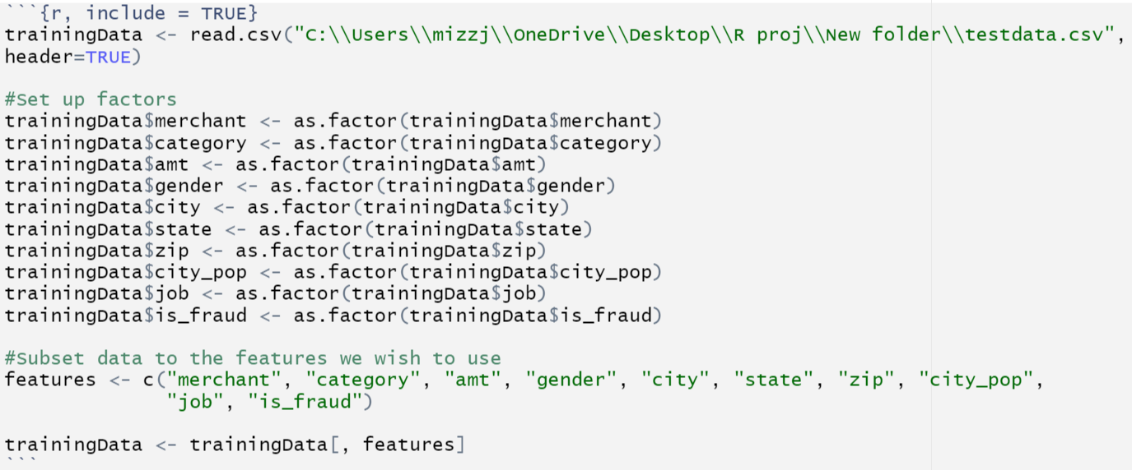
Methodology
After having a thorough understanding of the data, the data was imported into R studio. In R studio, a subset of the data was chosen that contained selected columns using the following command:

Slide 8
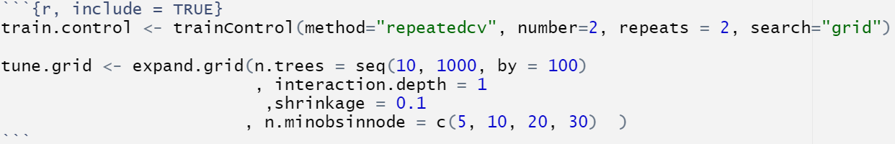

Once the training dataset was ready, the next step was to setup the parameters that will be used for creating and tuning the model. For this project, repeatedcv method was used in conjunction with grid search. Grid parameters were also provided.
In order to speed up the model creating process, virtual machines were setup in the background with the help of parallel and doSNOW packages.

Slide 9
After having the requisites in place, the model was then created using the following command. Once the model was created, the virtual machines that were setup for parallel computing were stopped.
The model was then applied to the test data and prediction was stored in the variable “preds” using the following command.

Slide 10
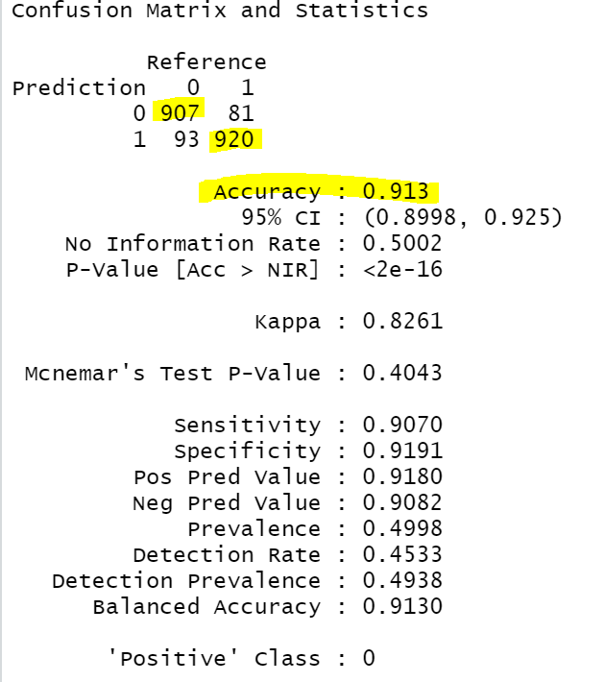
Results

Slide 11
Implications
Machine learning models in fraud analysis is a project under continuous technological development due the unique nature of each fraudulent transaction. Despite continuous efforts of development in anti-fraud machine learning models, countering fraudulent transactions could never be eradicated.
The implication of the inability of processing Big data on my personal device restricted the ability to process a larger dimension of parameters required to better train the model to provide higher accuracy. Building supervised machine learning models requires devices with dynamic capabilities.

Slide 12
Conclusion
Utilizing advanced supervised machine learning models that provide the highest accurate predictions will enable banks to stop fraud transactions before they occur that will result in eliminating the substantial financial losses associated with disputed transactions and chargebacks.
It is crucial for both parties involved, banks and their consumers to consider applying the higher security measures to reduce fraud. For example: using virtual credit cards, deleting credit card information after each transaction, encrypting sensitive data, conducting frequent updates on software and web applications, and only selecting highly trusted and secure e-commerce platforms and payment processors.
Combating fraud is an activity that requires joining all possible resources. Since regulators, banks, and investment firms are continuously involved in monitoring suspicious activities and possible money laundering cases they must detect and inform each other about suspicious activities.

Slide 13
Resources
Jayasree, V., & Balan, R. V. S. (2013). A review on data mining in banking sector. American Journal of Applied Sciences, 10(10), 1160.
Shen, A., Tong, R., & Deng, Y. (2007, June). Application of classification models on credit card fraud detection. In 2007 International conference on service systems and service management (pp. 1-4). IEEE.
https://public.tableau.com/profile/federal.trade.commission#!/vizhome/TheBigViewAllSentinelReports/TopReports

